Slide 1
Forecasting at Scale: Transforming SuperKart Historical Sales Data into Predictive Intelligence
SuperKart Forecast & Model Deployment
Austin University – Post Graduate Program in Artificial Intelligence
2026-06-08

Slide 2
Contents / Agenda
Executive Summary
Business Problem Overview and Solution Approach
EDA Results
Data Preprocessing
Model Building
Model Performance Summary
Deployment
Recommendation – Adding Product Price (MRP)

Slide 3
Executive Summary
The Challenge
To optimize inventory management and refine regional tactics, SuperKart required a scalable, data-driven solution to forecast product-level sales revenue. Utilizing a robust dataset of 8,763 product-store records across 4 distinct outlets, the objective was to pinpoint the exact structural and commercial drivers of supermarket revenue.
The Solution
We evaluated multiple advanced ensemble frameworks, including Random Forest and XGBoost, utilizing hyperparameter tuning (GridSearchCV). The models demonstrated strong alignment on test data, yielding a Test R² of ~0.66, an RMSE of ~₹616, and a MAPE of 18.7%. Based on its superior stability and consistent error minimization, the tuned Random Forest was selected as the final production model.
Strategic Insights
Revenue is heavily dictated by store format, city tier, and pricing. Departmental Stores and Tier-1
City locations significantly outperformed Food Marts and Tier-3 settings. Notably, outlet OUT004
emerged as a critical driver, generating ₹15.4M—outperforming the other three outlets combined.
The Recommendation
Deploy the finalized Random Forest pipeline via a decoupled Flask API and Streamlit UI to immediately improve supply-chain efficiency and inventory planning. For phase-two development, integrating Product_MRP directly into production is highly recommended, as testing proves it will significantly maximize future predictive accuracy.
 | Random Forest | Random Forest Tuned | XGBoost | XGBoost Tuned
RMSE | 615.907 | 615.907 | 615.933 | 616.087
MAE | 485.311 | 485.311 | 485.430 | 485.835
R-squared | 0.669 | 0.669 | 0.668 | 0.668
Adj. R-squared | 0.667 | 0.667 | 0.667 | 0.667
MAPE | 0.187 | 0.187 | 0.187 | 0.187

Slide 4
Business Problem Overview and Solution Approach
Business Problem
SuperKart needs accurate product-store level sales forecasts to support better inventory planning, supply-chain optimization, and store performance benchmarking.
Because the target variable, Product_Store_Sales_Total, is continuous, this is framed as a regression problem.
Solution Approach / Methodology
The solution followed a structured machine-learning workflow
Exploratory Data Analysis Identified key sales drivers, data patterns, and potential data quality issues.
Data Preprocessing & Feature Engineering Prepared the dataset for modeling, including categorical encoding and pipeline creation.
Model Training & Comparison Trained and compared multiple tree-based and ensemble regression models using R², RMSE, MAE, and MAPE.
Model Tuning & Selection Tuned the strongest candidate models and selected the best-performing model based on test performance and generalization.
Deployment Deployed the final model as a forecasting service using an API and web application for business users.

Slide 5
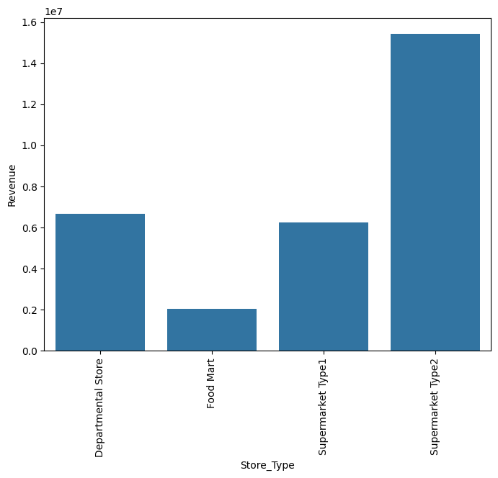
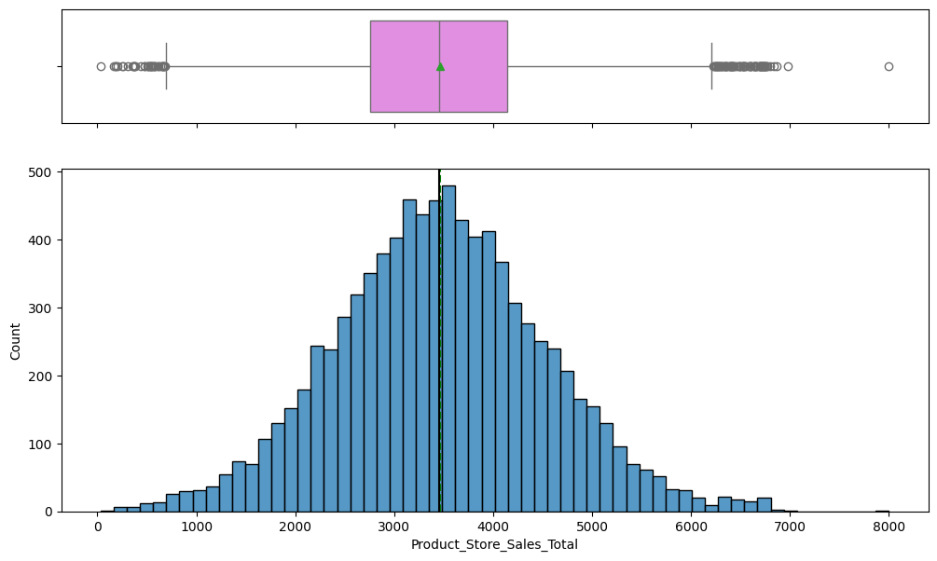
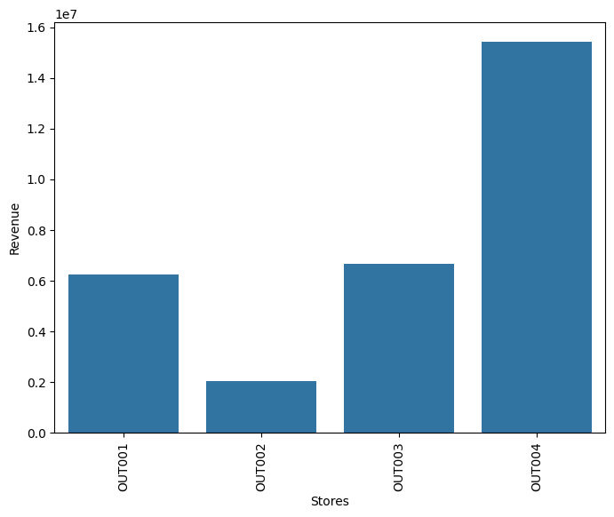
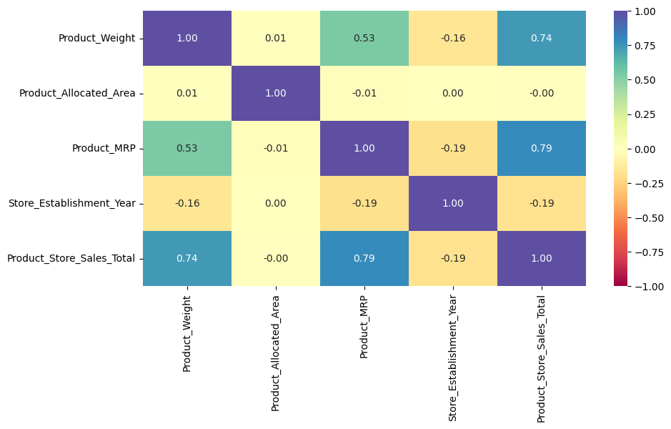
EDA Results
The sales target showed an average product-store sale of $3,464, with values ranging from $33 to $8,000 and a roughly symmetric distribution.
The strongest sales drivers were Product_MRP and Product_Weight, with correlations of 0.79 and 0.74, respectively. In contrast, Product_Allocated_Area showed almost no linear relationship with sales.
Sales performance varied significantly by store format. Departmental Stores generated the highest average sales, followed by Supermarket Type 1, Supermarket Type 2, and Food Mart.
City tier and store size also showed clear differences in sales. Tier 1 cities and high-size stores generated the strongest sales performance, while Tier 3 cities and smaller stores underperformed.
Outlet-level revenue was highly concentrated, with OUT004 contributing $15.4M, followed by OUT003 at $6.7M, OUT001 at $6.2M, and OUT002 at $2.0M.
Business implication: pricing, product attributes, store format, and location are the strongest indicators of expected sales and should guide inventory planning and regional sales strategy.

Slide 6
Data Preprocessing
Future Engineering
New variables were created to improve model performance and capture business-relevant patterns:
Store_Age_Years
Calculated store age using: 2025 - Store_Establishment_Year
Product_Id_char
Extracted the first two characters of Product_Id to identify broader product groups such as FD, DR, and NC
Product Category Grouping
Consolidated 16 detailed product types into two broader groups: Perishables and Non-Perishables

Slide 7
Data Preprocessing
Data Cleaning
The dataset was reviewed and standardized before modeling:
Standardized inconsistent values in Product_Sugar_Content, changing "reg" to "Regular."
Confirmed there were no missing values and no duplicate rows in the dataset
Data Preparation for Modeling
The final modeling dataset was prepared using a reusable preprocessing pipeline:
Dropped identifier and redundant columns:
Product_Id, Product_Type, Store_Id, and Store_Establishment_Year
Applied OneHotEncoder to categorical variables with handle_unknown="ignore" and passed numerical variables through unchanged
Split the data into a 70/30 train-test split (6,134 train / 2,629 test), random_state = 1

Slide 8
Data Preprocessing
Future Engineering
New variables were created to improve model performance and capture business-relevant patterns:
Store_Age_Years
Calculated store age using: 2025 - Store_Establishment_Year
Product_Id_char
Extracted the first two characters of Product_Id to identify broader product groups such as FD, DR, and NC
Product Category Grouping
Consolidated 16 detailed product types into two broader groups: Perishables and Non-Perishables

Slide 9
Data Background and Contents
Dataset Overview
The dataset contains 8,763 rows and 12 columns, with no
missing values and no duplicate records.
Product Attributes
Product-level features include:
• Product_Weight
• Product_Sugar_Content
• Product_Allocated_Area
• Product_Type
• Product_MRP

Slide 10
Data Background and Contents
Store Attributes
Store-level features include:
• Store_Establishment_Year
• Store_Size
• Store_Location_City_Type
• Store_Type
Identifiers
The dataset includes product and store identifiers:
• Product_Id
• Store_Id
• 4 outlets: OUT001 to OUT004
Target Variable
• Product_Store_Sales_Total
This represents the total sales revenue of a product at a specific store.
Data Coverage
The dataset covers 16 product types across 4 stores, spanning 3 city tiers and 3 store sizes.

Slide 11
Model Building
Built Random Forest and XGBoost regressors inside one preprocessing pipeline (one-hot encoded store/product categoricals); evaluated on the held-out test set.
Both base models perform almost identically — Test R² ≈ 0.668, RMSE ≈ 616, MAPE ≈ 18.7% — a statistical tie, with Random Forest holding a slight, consistent edge.
R² and RMSE are two views of the same errors (R² = 1 − RMSE²/Var(Y)), so they rank the models the same; MAPE ≈ 18.7% agrees, confirming the tie.
The models explain ~67% of sales variance, giving a solid baseline for demand planning.
Model (base) | Test R² | RMSE (₹) | MAE (₹) | MAPE
Random Forest | 0.668 | 616 | 485 | 18.7%
XGBoost | 0.668 | 616 | 485 | 18.7%

Slide 12
Model Improvement - Hyperparameter Tuning
Tuning Approach
Both finalist models were tuned using GridSearchCV.
• Cross-validation: 3-fold CV
• Scoring metric: R²
Random Forest Tuning Results
Best parameters:
• max_features = "sqrt"
• n_estimators = 100
• max_depth = None
The selected parameters were close to the default model settings.
Test performance:
• Test R² remained unchanged at 0.668
• Tuned Random Forest performed the same as the base Random Forest model
XGBoost Tuning Results
Best parameters:
• gamma = 0
• n_estimators = 100
The selected parameters were also near the default settings
.
Test performance:
• Test R² remained unchanged at 0.668
• RMSE remained around 616
• No meaningful performance gain was observed
Key Takeaway
Hyperparameter tuning did not produce a measurable improvement.
The models appear to have reached the performance ceiling based on the available features.
Since Random Forest and XGBoost remained statistically tied, the tuned Random Forest model was selected as the final model due to its stability, consistency, and simpler deployment profile.

Slide 13
Model Performance Summary
Final selected model: Tuned Random Forest (serialized with joblib and deployed).
All four models are statistically tied — Test R² ≈ 0.668, differing only at the 4th decimal — but Random Forest holds a slight, consistent edge over XGBoost across every metric.
Random Forest (tuned) was selected for deployment; the price-inclusive analysis (next slide) reinforces Random Forest as the stronger model family.
Selected-model test performance: R² = 0.668, RMSE = 616, MAE = 485, MAPE = 18.7%.
Model | Test R² | Adj R² | RMSE | MAE | MAPE
Random Forest (tuned) ★ deployed | 0.668 | 0.667 | 616 | 485 | 18.7%
Random Forest (base) | 0.668 | 0.667 | 616 | 485 | 18.7%
XGBoost (base) | 0.668 | 0.667 | 616 | 485 | 18.7%
XGBoost (tuned) | 0.668 | 0.667 | 616 | 486 | 18.7%

Slide 14
Deployment
Production Model
The tuned Random Forest model was serialized using joblib and deployed as the production forecasting model.
Backend API
The model is served through a Flask REST API.
• Endpoint: POST /v1/predict
• Input: product and store attributes
• Output: predicted sales value returned in JSON format
Frontend Application
A Steamlit web application was created to make the model accessible to business users.
The app supports:
• Single product-store sales predictions
• Batch scoring using CSV uploads
Hosting and Containerization
Both the backend API and frontend Streamlit app were containerized using Docker.
The solution is hosted on Hugging Face Spaces for deployment and accessibility.
Deployment Links
• Backend API:
https://araujohn-rkt-superkart-backend.hf.space
Endpoint:
POST /v1/predict
• Frontend Streamlit App:
https://araujohn-rkt-superkart-app.hf.space

Slide 15
Recommendation: Adding Product Price (MRP)
Product_MRP (price) is the single strongest predictor of sales in EDA (correlation 0.79), yet the current production model excludes it per project scope.
A controlled experiment adding Product_MRP improves every metric dramatically — and confirms Random Forest as the best model, widening its edge over XGBoost.
Business impact: typical forecast error roughly halves (RMSE 616 -> 291), enabling materially tighter inventory and supply-chain planning.
Recommendation: incorporate Product_MRP (and Product_Weight) in the next model iteration once approved for use.
Feature set | Best model | Test R² | RMSE | MAPE
Without price (current) | Random Forest (tuned) | 0.668 | 616 | 18.7%
With price (proposed) | Random Forest (tuned) | 0.926 | 291 | 5.2%

Slide 16
Key Takeaways & Business Recommendations
Key Business Drivers
Pricing and store format are the strongest sales levers in the dataset.
• Product_MRP has a strong correlation with sales at 0.79
• Departmental and Tier-1 stores generate approximately 3x higher sales than Food Mart and Tier-3 stores
Replicate High-Performing Store Patterns
SuperKart should analyze and replicate the success factors behind OUT004 and Departmental / Tier-1 store formats.
Focus areas include:
• Product assortment
• Pricing strategy
• Inventory availability
• Store format and location strategy
Model Selection
Random Forest and XGBoost performed very similarly, with Test R² around 0.668.
The tuned Random Forest model was selected and deployed due to its slight performance edge, stability, and simpler production profile.
XGBoost can be selected for a large amount of data, its parallelism improves performance.
Highest-Impact Model Improvement
The next major improvement should be to add Product_MRP to the model.
A controlled test showed that including Product_MRP could:
• Increase Test R² from approximately 0.67 to 0.93
• Reduce typical prediction error by roughly half
Production Readiness
The forecasting solution is production-ready through a Flask API and Streamlit web app hosted on Hugging Face Spaces.
Recommended operating approach:
• Monitor prediction accuracy over time
• Retrain periodically as new sales data becomes available

